Slide 1
Computer Hardware & Software
Session 1

Slide 2
Computer Hardware

Slide 3
Objectives
Discuss “The City Inside” and the components inside the CPU like the -
  Mother board
  Bus
  Cards
  Ports
  Memory
  Hard Disk Drive
  Floppy Disk Drive
  Power Supply Unit
  Computer Clock (Real Time Clock)

Slide 4
Objectives(Contd.)
Classify Computers
Identify a typical PC Configuration of -
  An ideal PC
  Multimedia – The magic of technology

Slide 5
“The City Inside”
The city inside shows the
Bus - transports data between the processor and other components
Motherboard - consists of a complex group of circuits
Controllers - controls the input/output work in the computer

Slide 6
“The City Inside”(Contd.)
Cards - fixed on slots contained in buses to enable the expansion of the computer
Ports - entry and exit points of buses

Slide 7
“The City Inside”(Contd.)
Memory
The hard disk drive
The floppy disk drive
The power supply unit
The computer clock

Slide 8
Memory
Memory is classified into two types
  Primary Memory
    RAM
    ROM
  Secondary Memory

Slide 9
RAM
Random Access Memory (RAM)
Essentially a read/write memory
While writing new data previous data gets
overwritten
RAM is volatile memory
RAM may be classified as:
  Dynamic RAM
  Static RAM

Slide 10
ROM
Read Only Memory
Essential functions are stored on the ROM
Data can be read randomly from the ROM
Data cannot be written onto the ROM
Data is hardwired onto these chips at the
time of manufacture
It is part of the computer system
ROM is non-volatile storage

Slide 11
ROM
Though data is hardwired, the user is able to program the following types of ROM :
  PROM
  EPROM
  EEPROM

Slide 12
PROM
Programmable Read Only Memory
Chips are programmed by burning a
fusible link within selected cells
A fused link cannot be restored
Operations once written cannot be erased

Slide 13
EPROM
Erasable Programmable Read Only Memory
Possible to erase and reprogram the ROM
Erasing is done by exposing the EPROM to ultraviolet rays of a specific frequency

Slide 14
EEPROM
Electrically Erasable Programmable Read
Only Memory
Can be programmed through special
electric pulses
Circuitry can be integrated into the
computer
EEPROM does have to be removed from its
socket for programming

Slide 15
Secondary Memory
Found outside the CPU box
Also called external memory or external storage
Some examples -
  floppy disks
  tapes
  cartridges
  compact discs

Slide 16
Hard Disk
It is the work horse of the computer system
Data is stored on platters
Data is stored or retrieved using a
read/write head
During a read/write, the head is stationary
while the platter rotates at a very high
speed beneath it.

Slide 17
Hard Disk (Contd.)
Data is organised in a set of concentric
rings called tracks
Each track is divided into sectors
The read/write head may be fixed or movable

Slide 18
Hard Disk (Contd.)
Fixed Head
Tracks

Slide 19
Hard Disk (Contd.)
Movable Head
Tracks

Slide 20
Hard Disk (Contd.)
A set of corresponding tracks on all surfaces of the disk pack
equidistant from the spindle is called a cylinder
Seek time is the time taken to reach the specified cylinder/track
Rotational latency is time taken for the specified sector to reach read/write head

Slide 21
Hard Disk (Contd.)
Average access time =
average latency + average seek time
The full set of these platters and the read/write heads are enclosed in a vacuumed container, to protect it from dust and electrical shocks

Slide 22
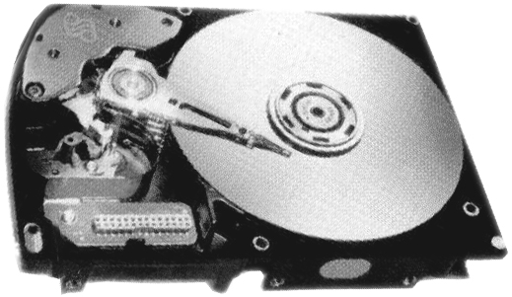
Hard Disk (Contd.)

Slide 23
Floppy Disk
Allows information to be exchanged between two computers.
One of the easiest and cost effective ways to exchange information
It is enclosed in a plastic jacket to protect it from heat, dust and electrical shocks.

Slide 24
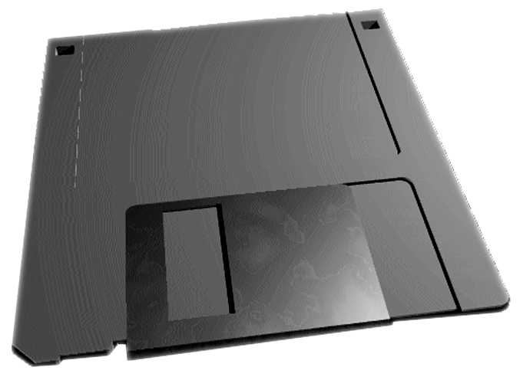
Floppy Disk (Contd.)
They can be made ‘write protect’, to prevent accidental loss of data

Slide 25
Classification of Computers
Computers can be classified on the basis
of -
Purpose
Components
Size and processing power

Slide 26
Classification of Computers (Contd.)
Purpose
Analog Computers
Digital Computers
Hybrid Computers

Slide 27
Classification of Computers (Contd.)
Components
First generation of computers
Second generation of computers
Third generation of computers
Fourth generation of computers
Fifth generation of computers

Slide 28
Classification of Computers (Contd.)
Size and processing power
Microcomputers
Minicomputers
Mainframes
Supercomputers

Slide 29
Configuration
Configuration refers to the manner in which the hardware and software of an information processing system are organised and interconnected.

Slide 30
The Ideal PC (11/2004)
P4 3.0GHZ / Bus 800/ Cache 1MB
Motherboard Intel 915GAV/2x
Ram 256MB
HDD 80GB (7200 rpm)/ DVD 16X
FDD1.44MB/ A keyboard/ Mouse Optical
Monitor 17“/ USB/ Parallel/ Serial ports
Fax Modem
Sound Blaster /Speakers
Windows 2000/ XP /2003

Slide 31
Multimedia
The multimedia kit consists of -
the sound blaster card
the speakers and
the CD ROM drive
...

Slide 32
Computers and Software

Slide 33
Objectives
Define Software
Explain Software with examples
Classify Computer Languages
List varieties of software
Summarise the role of software
Describe what is Housekeeping

Slide 34
Objectives (contd...)
Discuss the Booting process
Discuss various concepts related to software like
  Virus, Anti-virus, Vaccine
  Data compression
  File Creation
  Software versions
  Software manuals
  Software copyrights
  Software upgrades

Slide 35
What is Software?
Software is a set of instructions that are given to the computer which help the computer to process data and give information.

Slide 36
How does software get made?
Software instruction are written using tools called ‘languages’. Languages are the medium through which human beings communicate with computers as they do with each other.

Slide 37
Classification of Languages
First generation languages / Machine language
Second generation languages / Assembly language
Third generation language
Forth generation language

Slide 38
1st GL
Language made up of 0s and 1s.
Very difficult to use.
Also called machine language.

Slide 39
2nd GL
Also called assembly language.
Consisted of mnemonics.
Common procedures had short cut codes to long commands.
Example: used machines like
IBM 1401.

Slide 40
3rd GL
Very similar to English language
Also called high-level language
Needs a translator for the computer to understand the language
Examples: BASIC, COBOL, C.

Slide 41
4th GL
These languages are tools that allow large amount of data to be collected, stored and processed very easily.
Examples: dBase, Oracle, Ingres.

Slide 42
Varieties Of Software
Word processors - for letter writing
Spreadsheets - for performing mathematical calculations
Database - for keeping records
Graphic packages - for drawing
Networking - for telecom
Games - for fun!

Slide 43
Housekeeping
It is a process that facilitates the maintenance of computer hardware, computer software and data.

Slide 44
Maintaining Hardware
Keep the printer free from dust
Clean floppy drives regularly
Switch off the computer properly
Mouse should be cleaned regularly
Disks should be removed before switching off the computer.

Slide 45
Maintaining Software
Software giving problem should be bought to the notice of the person who developed it.
Keep software backups on a set of disks in case the original copy on the hard disk gets erased by mistake.

Slide 46
Maintaining data
Data loss can occur due to -
power failure
power surges
sudden computer break down

Slide 47
Avoid data loss by taking
Regular backups

Slide 48
The Booting Process
The booting process is the loading of the operating system from the hard disk into the RAM. This is helped by ROM.
This process is also called POST which stands for Power On Self Test.

Slide 49
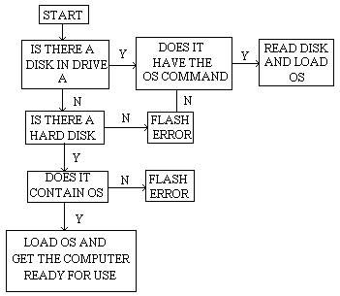
Loading of Operating System

Slide 50
Virus, Anti-virus, Vaccine
Virus is a destructive program
Anti-virus is a software that protects the computer from a virus attack
Vaccine is a program that removes virus from the computer

Slide 51
Data Compression
Data compression is a technique that allows data to be packed close together so that the data file becomes smaller in size. This helps reduce the storage space.

Slide 52
File Creation
File creation is the result of the user ‘saving’ the data and the data getting copied from the RAM to the hard disk under a name defined by the user.

Slide 53
Software Manuals
Software manuals teach
how to set up the software
how to maintain it
how to use it
how to fix small problems

